Slide 1
Yes, We Have the Data You Need:
Challenges and Solutions for Communicating Research Data to Faculty
Scientific Data Resources Forum, 08/08/2023
Yonah Karp,
Manager, Data Projects & Programs, KPWHRI
VIG Technical Lead, HCSRN

Slide 2

Who am I
  7 years at KPWA/ KPWHRI
  KPWHRI Research Data Warehouse
  Data engineering & integration, management, systems management & analysis
  Data contexts: finance, research, healthcare, other business
Notes:
Hi, if you don’t already know me, I’m Yonah Karp,
and I manage the Research Data Warehouse team
at the Kaiser Permanente Washington Health Research Institute
as well as several project programmers.
I’m also involved in the complicated relationship in modifying the Epic front end
for research projects.
And I'm also, as of last week, the VIG Technical Lead for the HCSRN.
My background includes academic work in math and mathematical statistics.
I’ve worked at three research institutions – University of Wisconsin, University of Washington, and of course, KPWHRI.
I’ve also worked in other data contexts. I’ve done a lot of different things. I’ll just mention a few of them.
I’ve worked in finance at JP Morgan Chase and State Street;
Worked as a software engineer and systems programmer and manager at the University of Washington.
I’ve worked with Truven Health Analytics on a project for the state of North Carolina,
And I’ve also worked in the world of web analytics, notably a company that hosts websites
for half the automotive companies,
analyzing consumer web traffic and behavior for companies like VW and GM.
And yes, I’ve used SAS, off and on, since I was in college the 1980s.
And SQL, of course, many flavors, and various other programming and scripting languages.

Slide 3
Research Data: Do you have ∞ ? &?
  Naming the Problem
  Refining our Understanding
  Small Grant – Strategy & Execution
  RDW SharePoint Site
  Prep-to-Research options
  Future Plans
  Questions?
Notes:
So, what I’ll be talking about today is a problem
that spans every organization I’ve ever worked in
– and the problem is not about data.
It’s about communication.
Do you have this data? Can I find out that information?
How do I solve a particular problem that requires data?
And our data is really complicated. It’s built off the EHR data and other business sources,
Probably very similar to other HCSRN sites –
but even what starts out seeming like a simple question – for example,
“how many people got levothyroxine in the month of May 2023,
and which of them also had this particular diagnosis”
is a lot more complicated than it looks on the surface.
There’s a lot of nuance. The rules for how the data is built – just for the HCSRN VDW –
Not talking about any other model –
have been developed over maybe 20 years and have evolved,
so even if you knew how data was built in a particular subject area five years ago,
or what the subject areas were, you’d be behind.
Communicating this nuance in the data sources, starting at a high level,
and then being able to drill down to a deeper and more complex level,
depending on individual needs, was our goal.
We had the big-picture goal of creating a resource that people could interact with at any level of starting knowledge. And we wanted to build something that people could come back to again and again.
So, I’ll be walking through our effort, at KPWHRI, to solve the problem of communicating our data options to the Institute at large, particularly to faculty, project managers and others - especially non-programmers.
I'll be talking about the small grant I put together to address this problem, the investigation we did, and where those efforts took us.
And then I'll spend the rest of our time walking you through the research data warehouse SharePoint site, which is one of the main solutions that we built, and that we continue to enhance, to communicate our data capabilities.
I’ll also touch on the prep-to-research options for faculty, project managers (and, of course, programmers).
I'll take questions at the end. I won’t be able to look at the chat until it’s time for Q&A, and Roy will be helping me collate those questions so I can answer them.

Slide 4
RDW Internal Communications Strategy: Naming the Problem
Notes:
I’ve been at the Institute for five years, and I've worked in various capacities with the RDW,
first as a data engineer and builder of research data, and also as a project programmer
who pulls from these data stores for study needs,
And now, as the manager of the data warehouse group for the last few years.
Over my time at the Institute, I've noticed a few things,
I've noticed that our excellent programmers, who are often embedded on research projects,
are the main source of information about available data.
They're the source of truth and that works a lot of the time.
However, what I've seen in my time here are various questions and gaps in people's knowledge,
and that's true for everyone, programmers, faculty, PMs – RDW – me…
Looking on the left-hand side of this slide:
what I've seen is that programmers communicate well with both the RDW and faculty,
and they're the brokers of what data is available.
And the RDW, the research data warehouse team,
we communicate well with both programmers and IT,
but there's not a ton of direct communication with faculty.
We’re in our own little silo.
So, on the top right of the slide –
Faculty is getting most of the information about available data offerings and future capabilities
from programmers, and that's efficient, but it's incomplete,
my observation has been that faculty is missing opportunities.
What I believe has been missing is the ability to communicate
our current data offerings better.
And to understand research faculty needs better.
Communication is good here and there,
But when I started thinking about this a couple of years ago in the hopes of fixing it,
I was wanting us to build something more consistent,
and also wanted to give researchers knowledge about what we're capable of building as well –
not just what we’ve already built –
so that they're poised to compete for the widest variety of grants.
The ongoing need we’re continuing to address with the RDW site –
communications between the Data Warehouse team and faculty/ project personnel.
That includes an evergreen source of easily findable information for project programmers, as well.

Slide 5
Small Grant – Strategy & Execution – Spring 2021 Plan
GOAL: Raise awareness among faculty of the RDW’s current structure, function, data models built, data areas and capabilities that can be accessed by programmers and researchers
GOAL: Raise awareness of future capabilities which will allow for increased funding opportunities
METHOD: 4 months half-time Communications Consultant + RDW + Eagles
GOAL: More informed faculty, better flow of communication
Deliverables:
  Communication strategy + workplan to support the objective
  Site map and draft text for intranet web pages
  More informed faculty
Notes:
We had an internal opportunity here at KPWHRI to compete for small grants for work that didn’t fall under typical work.
I was able to get one, and
the goal of this small grant was to raise awareness of what we currently do,
in detail, in a consistent and understandable way, and what we can do.
Everything I just said, data models, whatever data products we build,
data areas, capabilities, future capabilities.
And the way that we worked on making this vision happen –
through the small grant, we were given funding for a halftime communication consultant working
with us, connecting with our internal communication group (the Eagles).
The goal was more informed faculty, and better flow of communication.
Deliverables of the grant were a communications strategy and a work plan to support that objective,
a site map and some draft text, and of course the overarching but unmeasurable goal, more informed faculty.

Slide 6
Small Grant – Strategy & Execution – What Actually Happened (2021-2)
2 months half-time Communications Consultant (of 4-month contract)
      Consultant & I interviewed 11 faculty and 4 RDW members
      Helped to refine my understanding of the problem
      Consultant delivered communication strategy & draft text
Regrouping efforts
      Attempts to hire new consultant were difficult
      Discovery that creating SharePoint was straightforward – 4 clicks
        Unfortunately, it’s a lot more than that to create a decent SP site
      Discussions with local communications folks
Notes:
Well, what actually happened?
We had a communications consultant for about half that time.
And she was wonderful. But she got a full-time job, can’t blame her. So, she left about halfway through.
While she was here, she and I interviewed 11 faculty and the data warehouse team.
And we delivered a communication strategy, some draft Internet pages, and the beginnings of some text.
And after she left, there was some difficulty in regrouping. We tried to hire a new consultant. That ultimately did not happen.
And I discovered that creating a SharePoint site was really straightforward.
It's like four clicks, so that was a great discovery, except that it's a lot more than that
to create a decent SharePoint site. So that’s where the work came in.
So, I started building the SharePoint site, got some guidance from our local communications people.
And the data warehouse folks, Roy, John and Al, helped build out the data pages.
And of course, they were only too happy to give ongoing input.

Slide 7
RDW SharePoint Site
Site map: RDW SharePoint Site Map.docx – original structural concept
SharePoint site:
      Data
      Getting Started
      All the Data Warehouses
      Special Data Topics
      Links
      Quick Numbers
Notes:
Go to the Word Document:
RDW SharePoint Walkthrough for SDRF Presentation August 2023

Slide 8
Prep-to-Research Tools
Quick Numbers section of site
Counters
Planned Enrollment
RDW Dashboard

Slide 9
Future Plans
  Enhance dashboards
  Other special data topics
  Data Insider –
  New format
Lots to learn & build
Notes:
For the future,
We’d like to include more data topics
Go further with dashboards
Enhance git/ github training
Would like a page dedicated to better understanding of all data models
Would like links to useful business dashboards (which would require an analysis of the huge offerings from the business analytics group)

Slide 10

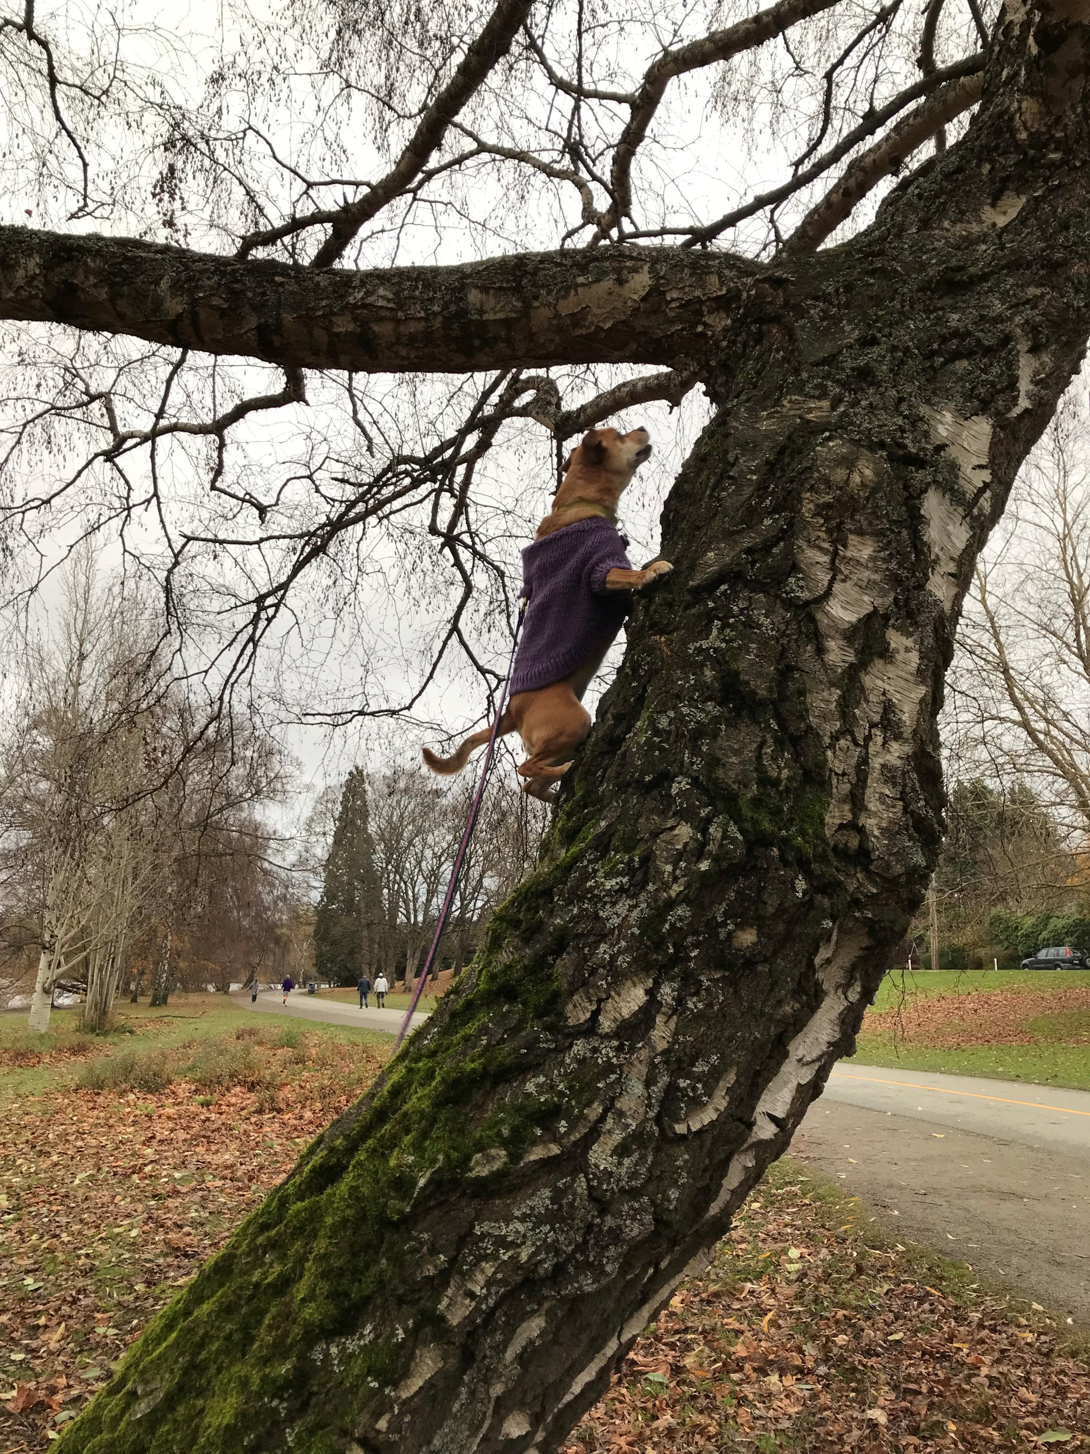
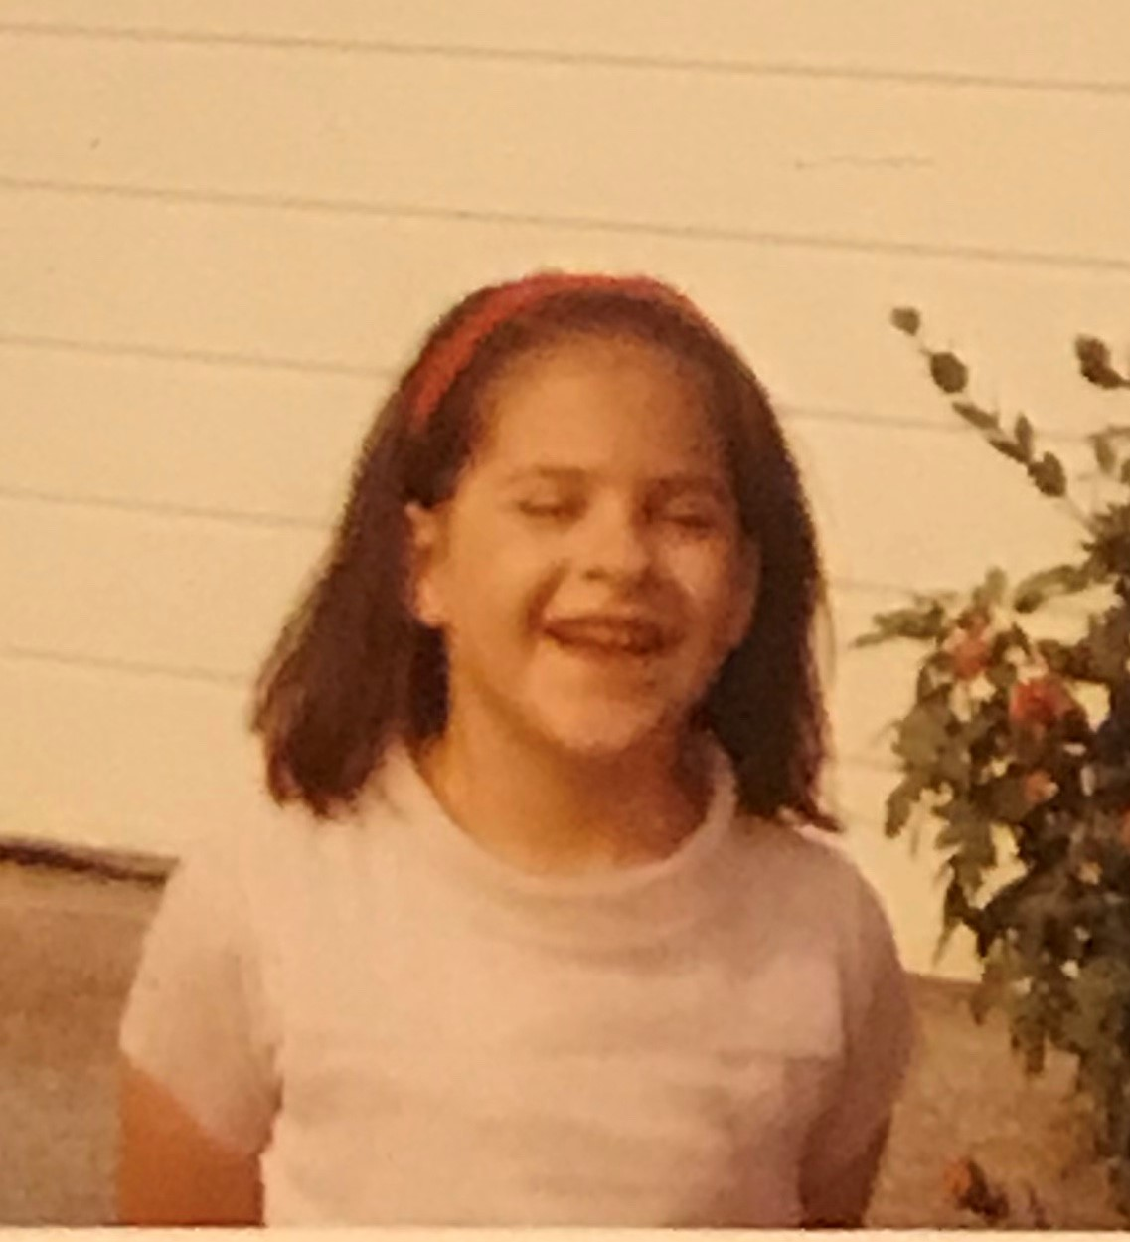
Questions? (Greenlake and long-ago me)

Slide 11
Thanks for attending!
Yes, We Have the Data You Need:
Challenges and Solutions for Communicating Research Data to Faculty
Scientific Data Resources Forum, 08/08/2023
Yonah Karp, KPWHRI

