Slide 1
Use of Patient Reported Outcomes in Mental Health Research
Arne Beck, PhD
Scientific Data Resources Forum
May 9th, 2023

Slide 2
Overview
Use of PRO measures in the Mental Health Research Network (MHRN) Mindful Mood Balance for Moms (MMBFM) Trial
Use of PRO measures in research and evaluation on improving quality of depression care at KPCO
Integration of PRO Data into Care Pathways for Depression

Slide 3
Mindful Mood Balance for Moms Pragmatic Trial aims
Evaluate a digital program, Mindful Mood Balance for Moms, MMBFM, for prevention of perinatal depression. Four Mental Health Research Network (MHRN) sites: KPCO, KPSC, KPGA, and HP; N=423
Aim 1: Compare the clinical effectiveness of MMBFM supported by clinician vs. peer coaches among women with a history of depression.
  Depression symptoms assessed by PHQ-9 at baseline and three months post-randomization

Slide 4


Slide 5
PRO Outcome Measures for AIM 1
Use of PHQ-9 / EPDS from prenatal depression screening in OB for cohort selection
PHQ-9 cascade to CSSRS after enrollment for safety alerts
Clinical effectiveness of MMBFM supported by clinician vs. peer coaches.
  Are there differential reductions in depression symptoms, assessed by the PHQ-9, at three-months post-randomization?
  Sources for PHQ-9 data
    Part of larger three-month research survey
    Depression screening data in the VDW, obtained from obstetric, behavioral health, and primary care settings
PRO data collected in routine clinical care are essential to research
Notes:
List more common ones: Gad-7, SF-12, PSS

Slide 6
Research on Quality Improvement for Depression Care
Identifying sources of PHQ-9 screening and follow-up data routinely collected in clinical care – VDW and clarity tables
Part of HEDIS quality measure for
  Depression Screening and Follow-up (DSF)
  Depression Monitoring of Symptoms (DMS)
  Depression Remission or Response (DRR)
Routinely collected PRO data are essential to quality improvement

Slide 7
Integration of PRO Data into Care Pathways for Depression

Slide 8
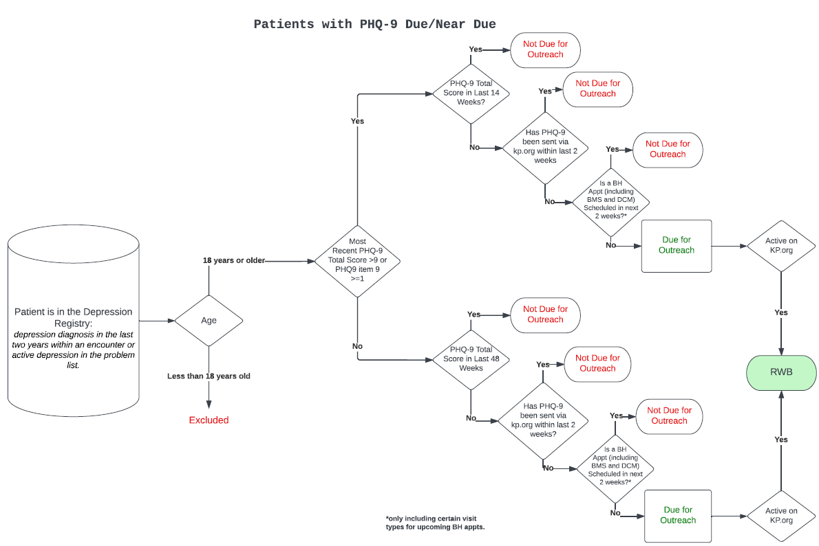

Slide 9
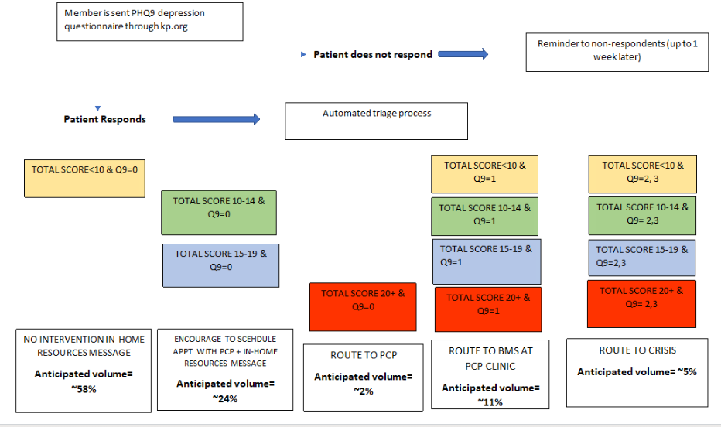
Automated results routing pathways based on PHQ item 9 and total score

Slide 10
Questions?

