Slide 1


Impact of a Multi-Faceted Best Practice Alert among Patients with Headaches seen in Primary Care
Dr. Apoorva M. Pradhan BAMS, MPH
Center for Pharmacy Innovations and Outcomes
Geisinger

Slide 2

Disclosure
I have no disclosures
This study was supported internally by Geisinger Clinical Research Funds from Geisinger Neurology and Center for Pharmacy Innovations and Outcomes

Slide 3
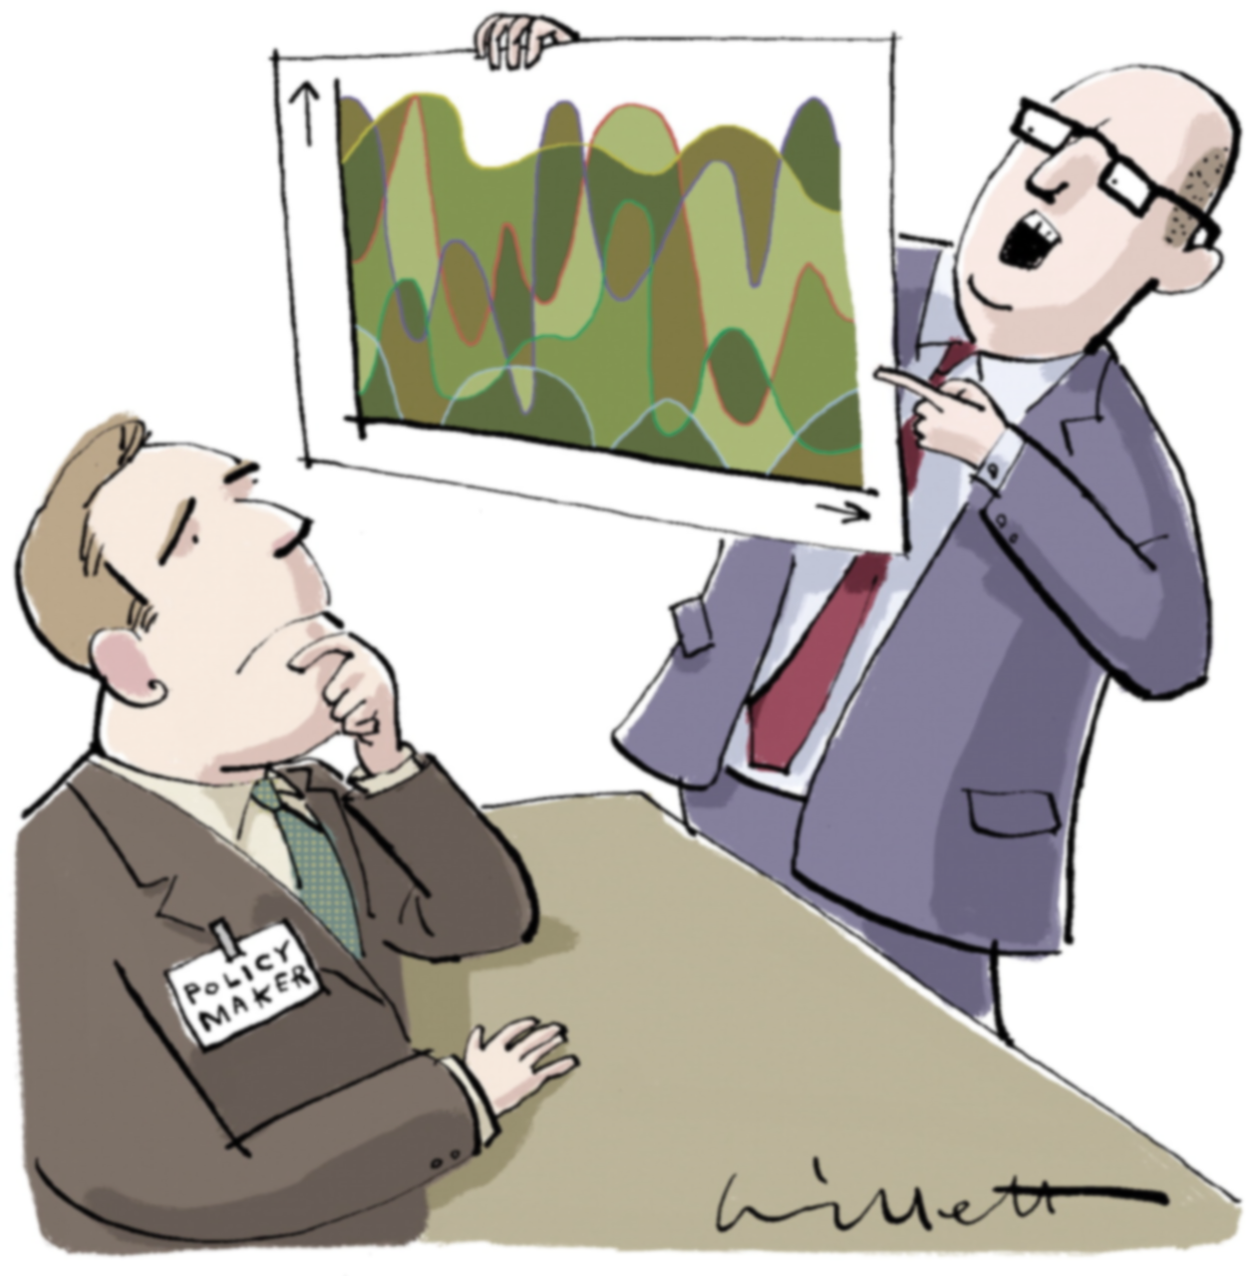
Objectives
Understand the need for a point of care tool in headache management
Describe the design and implementation of the best practice alert
Summarize the results of the evaluation study
Discuss the limitations and implications of the findings of the evaluation study
Sneak peak into next steps

Slide 4

Introduction
A major public health concerns globally.¹
The second most common global cause of disability (in particular migraine).²
Increased prevalence over the last 3 years from 35% to 52%.³
Associated with significant socioeconomic burden, especially due to the loss of productivity.⁴
Responsible for 3% of annual ED visits in the US.⁵
Stovner LJ, Nichols E, Steiner TJ, et al. Global, regional, and national burden of migraine and tension-type headache, 1990-2016: a systematic analysis for the Global Burden of Disease Study 2016. Lancet Neurol. 2018;17:954–976.
Steiner TJ, Stovner LJ, Jensen R, Uluduz D, and Katsarava (2020) Migraine remains second among the world's causes of disability, and first among young women: findings from GBD2019. J Headache Pain 21: 137
Stovner LJ, Hagen K, Linde M, Steiner TJ. The global prevalence of headache: an update, with analysis of the influences of methodological factors on prevalence estimates. J Headache Pain. 2022;23(1):34. Published 2022 Apr 12. doi:10.1186/s10194-022-01402-2
Yucel A, Thach A, Kumar S, Loden C, Bensink M, Goldfarb N. Estimating the economic burden of migraine on US employers. Am J Manag Care. 2020 Dec 1;26(12):e403-e408. doi: 10.37765/ajmc.2020.88547. PMID: 33315334.
Burch R, Rizzoli P, Loder E. The Prevalence and Impact of Migraine and Severe Headache in the United States: Figures and Trends From Government Health Studies. Headache. 2018 Apr;58(4):496-505. doi: 10.1111/head.13281. Epub 2018 Mar 12. PMID: 29527677.

Slide 5

Introduction
Only 4% of HA patients seek PCP care.⁶
Neuro referral from PCP 30% are HA.⁷
Geisinger Neurology HA Data
  100 referrals per month
  Average wait 4-6 months
  Only 2 headache specialists
  50% of patients have not tried any Rx
  30% have only tried one Rx
Geisinger ER data
  6000 patients per year
  More than half are not under treatment
Rua T, Mazumder A, Akande Y, Margariti C, Ochulor J, Turville J, Razavi R, Peacock JL, McCrone P, Goh V, Shearer J, Afridi S. Management of chronic headache with referral from primary care to direct access to MRI compared with Neurology services: an observational prospective study in London. BMJ Open. 2020 Oct 16;10(10):e036097. doi: 10.1136/bmjopen-2019-036097. PMID: 33067273; PMCID: PMC7569948.
Fernandes L, Tanti M, Randall M, et al. 111 An audit of headache referrals from primary care, and subsequent management in the outpatient clinic. Journal of neurology, neurosurgery and psychiatry 2019. DOI: 10.1136/jnnp-2019-ABN-2.110.
Notes:
HA among top 5 reasons for ED visit at Geisinger
Talk about increased use of HER alerts; mixed effectiveness results but applied across various disease states with the intent to influence provider behaviors

Slide 6

Objective
To implement and evaluate the impact of an EHR-based best practice alert (BPA) tool on patient reported outcomes and healthcare resource utilization over a 6-month period in patients with primary headache disorders seen at Geisinger’s primary care using a pragmatic randomized control trial.

Slide 7

Methods
A prospective cluster-randomized control trial at 38 Geisinger PCP sites
The intervention was an interruptive Best Practice Alert (BPA) tool that was pilot tested
Patient inclusion criteria
    PCP entered HA as a visit diagnosis or chief complaint in the EHR at the time of encounter AND
    18 years or greater at the time of the clinical encounter AND
    Significant HA burden as defined as:
      Baseline HA Impact Test 6 (HIT-6) score of 50 or higher OR
      had headache frequency of 12 days or greater in the last three months.
Exclusion criteria
  Diagnosed with secondary HA disorders
    serious systemic illness or acute infection
    headaches due to fall or injury
    pregnant women
  Actively managed by neurology for HA
Notes:
Types of headaches included - migraine, chronic daily, tension-type, cluster, or medication overuse headaches.
For this study, we will be referring to all the different types of primary headache disorders mentioned earlier as “headaches.”

Slide 8
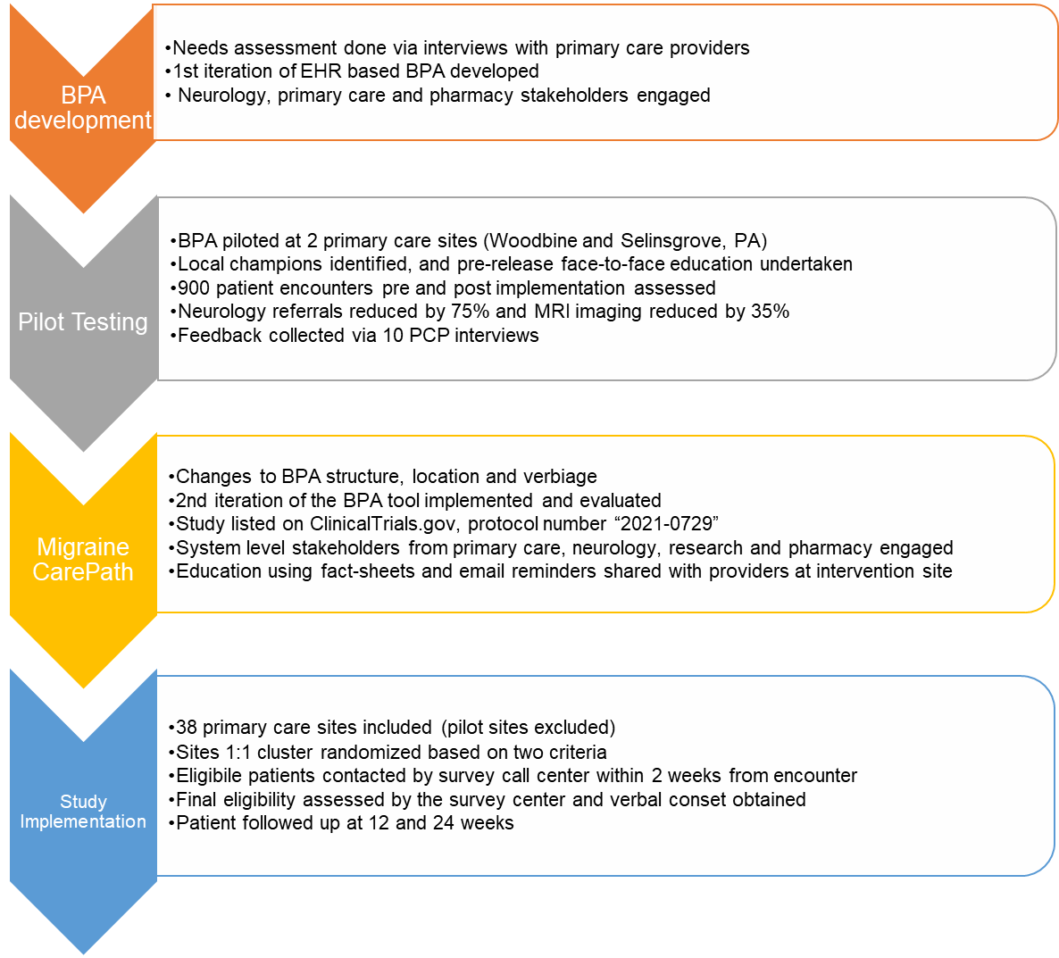
Methods – Tool Development and Implementation Process
Notes:
Cluster randomization based on region and patient to provider ratio

Slide 9
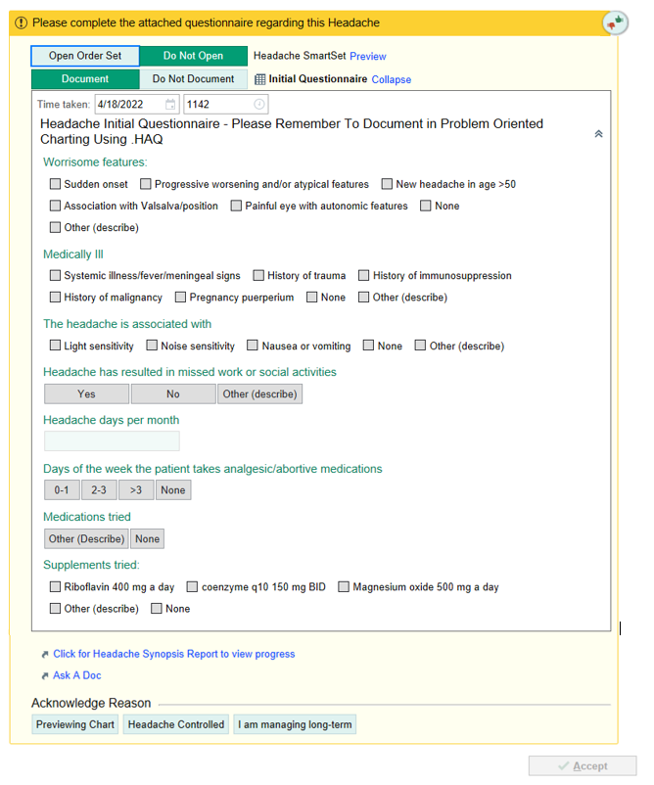
Methods – BPA Tool
The intervention BPA consisted of 4 parts:
  Questionnaire to assist in HA characterization

Slide 10
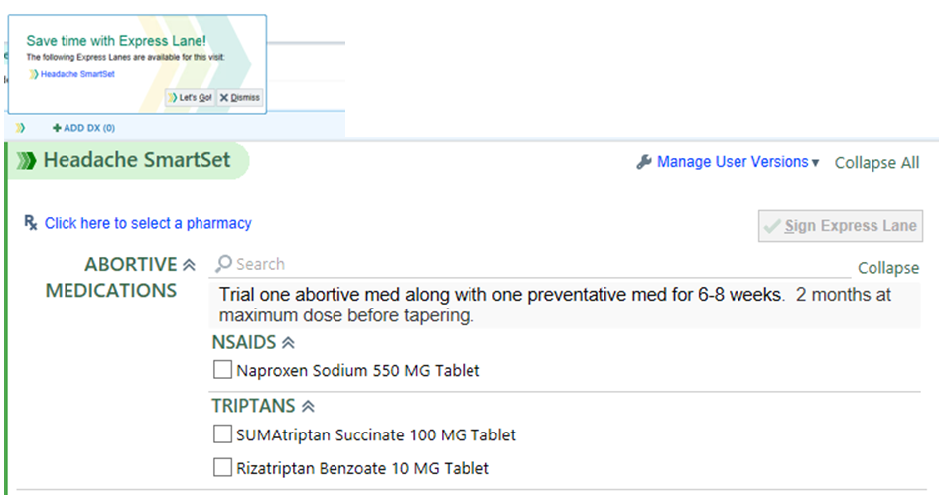
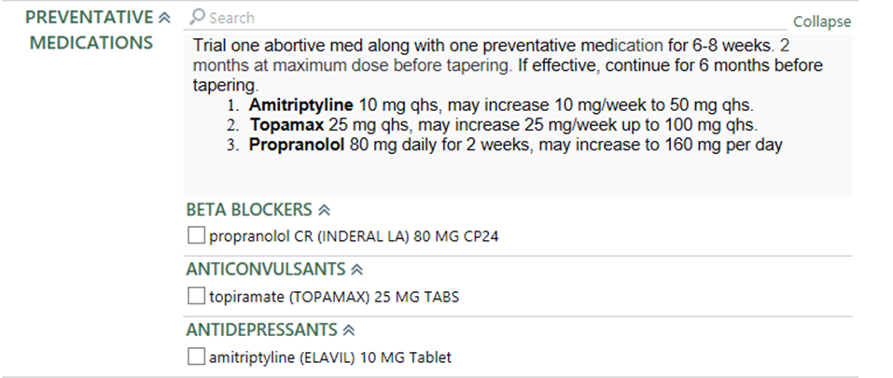
Methods – BPA Tool
The intervention BPA consisted of 4 parts:
  Questionnaire to assist in HA characterization
  “Smart Set” to guide ordering medications, imaging, labs, and referrals

Slide 11
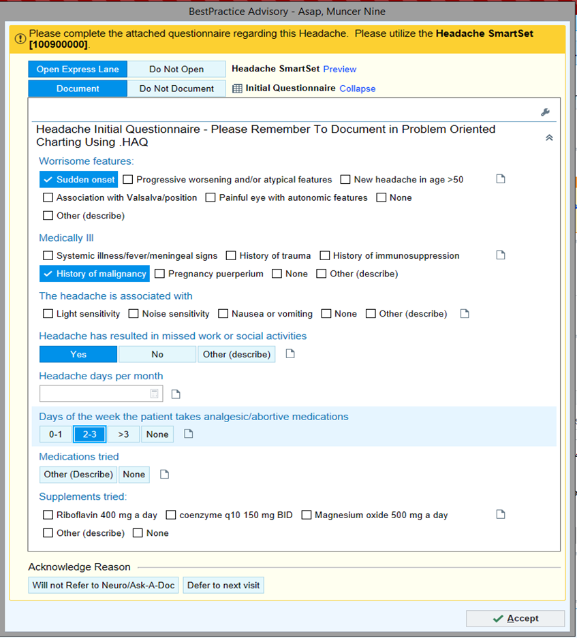
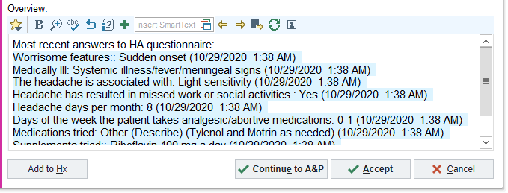
Methods – BPA Tool
The intervention BPA consisted of 4 parts:
  Questionnaire to assist in HA characterization
  “Smart Set” to guide ordering medications, imaging, labs, and referrals
  “Ask a Doc” - request a neurology e-consult/chart review for guidance of care
  Synopsis –an EPIC generated HA overview
Control sites did not see the BPA.

Slide 12

Methods
Outcomes collected from the EHR and through a survey administered by Geisinger’s Survey Core at baseline, 3 months, and 6 months.
13 questions
    HA impact on daily life (HIT-6)
    Pain intensity and frequency
    Benefit of medications (M-TOQ)
    Sociodemographic data
Notes:
the Migraine Treatment Optimization Questionnaire (M-TOQ), which determines if a medication treatment for a participant is optimal;
Sociodemo – income and education

Slide 13

Methods - Outcomes
Patient Reported Outcomes
Primary Outcome:
  Change in HIT-6 scores
  Secondary outcomes
  Change in the frequency of headache days observed in the last 90 days
  Change in self-reported pain intensity scores (0 - no pain at all to 10 - the worst pain ever).

Slide 14

Methods – Secondary Outcomes
Healthcare Resource Utilization Outcomes
  Emergency room visits
      All cause
      Headache specific
    Neurology referral
    Prescription medication initiation
        Preventative medications
        Rescue medications
        Injectable medications CGRP
Notes:
6 months before and after

Slide 15
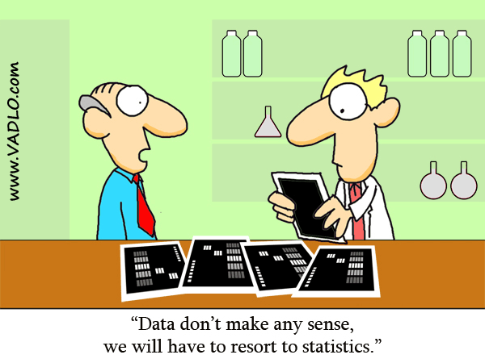
Methods
“Intention-to-treat” approach used for all analyses
Descriptive statistics for baseline sociodemographic characteristics.
Groups were compared using:
  two-tailed t-tests for normal data
  χ² was for categorical data
  Mann-Whitney for non-normal quantitative data
Generalized estimating equations models used to do a difference-in-difference (D-I-D) analysis.
An unadjusted GEE model developed as a first step. Demographic variables that were significantly different between groups (p <0.05) were included in the multivariable (adjusted) model.

Slide 16
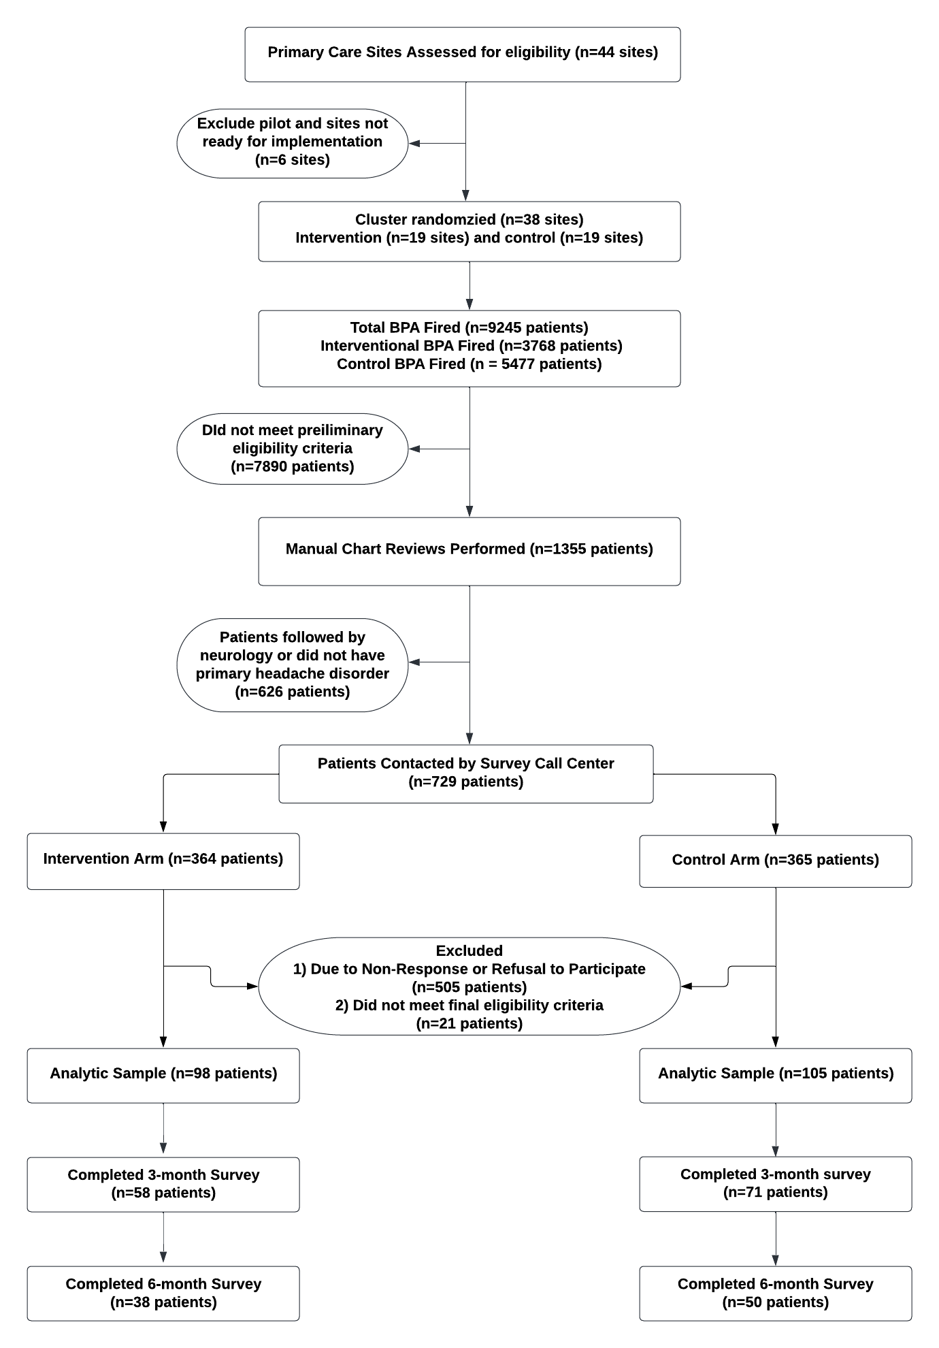
Results – Consort Diagram

Slide 17
Results – Implementation Outcomes
205 PCPs exposed to the interventional alert
Interruptive alert fired 3768 times
83% were overridden/dismissed
5% were ignored
15 PCPs provided feedback
3 found it helpful
12 provided negative feedback

Slide 18
Results – Demographic Breakdown
 | Intervention Arm | Control Arm | P-value
Total patient (N) | 98 | 105
Demographics
Age, in years Mean (SD*) | 43.18 (14.4) | 39.05 (14.4) | 0.04*
Sex, N (%) Males Females | 28 (28.6) 70 (71.4) | 21 (20) 84 (80) | 0.19
Race, N (%) White African American Other | 95 (97.0) 2 (2.0) 1 (1.0) | 98 (94.2) 2 (1.9) 4 (3.8) | 0.56
Ethnicity, N (%) Non-Hispanic Hispanic | 92 (93.9) 6 (6.1) | 95 (91.4) 9 (8.6) | 0.60
Type of insurance at most recent encounter, N members (%) Commercial Medicare Medicaid Other | 59 (60.2) 13 (13.3) 26 (26.7) 0 | 56 (53.3) 12 (11.4) 31 (29.5) 6 (5.8) | 0.32
*p – value < 0.05

Slide 19
Results
 | Intervention Arm | Control Arm | P-value
Total patient (N) | 98 | 105
HIT-6 scores | 62.97 (6.88) | 61.79 (6.55) | 0.21
Number of Headache days, Mean (SD) | 31 (26) | 29 (23) | 0.56
Pain Scores, Mean (SD) | 6.92 (1.82) | 6.87 (1.87) | 0.84
Patient reported use of preventive or abortive medications, N (%) | 63 (68.5) | 57 (58.2) | 0.14
*p – value < 0.05

Slide 20
Results
Outcome | Arm | Phase | N | Mean (SD) | Average Change | D-I-D Estimate (Risk difference/Odds Ratio) | P-value for D-I-D
HIT-6 Score Primary outcome | Intervention | Baseline | 98 | 62.97 (6.9) | 4.29* | -1.89 (-4.99 – 1.31) | 0.25
 |  | Month 6 | 38 | 58.68 (8.6)
 | Control | Baseline | 105 | 61.79 (6.5) | 1.71
 |  | Month 6 | 50 | 60.08 (8.7)
Headache Days | Intervention | Baseline | 98 | 30.94 (25.8) | 8.18 | 1.22 (0.82 – 1.81) | 0.33
 |  | Month 6 | 38 | 22.76 (26.2)
 | Control | Baseline | 105 | 28.90 (23.5) | 10.47*
 |  | Month 6 | 50 | 18.44 (18.2)
Pain | Intervention | Baseline | 98 | 6.92 (1.8) | 0.42 | 0.99 (0.90 – 1.11) | 0.92
 |  | Month 6 | 38 | 6.50 (1.8)
 | Control | Baseline | 105 | 6.87 (1.9) | 0.45
 |  | Month 6 | 50 | 6.42 (2.1)
*p – value < 0.05

Slide 21
Results
Outcome | Arm | Phase | Utilization, % | % Change | D-I-D Estimate(Odds Ratio) | P-value for D-I-D
ED Utilization | Intervention (n=98) | Baseline | 19.4 | -2.0 | 1.40 (0.58 – 3.38) | 0.46
 |  | Month 6 | 17.4
 | Control (n=105) | Baseline | 14.3 | -4.8
 |  | Month 6 | 9.5
Neurology Referral | Intervention (n=98) | Baseline | 2.0 | 12.3* | 0.52 (0.06 – 4.29) | 0.55
 |  | Month 6 | 14.3
 | Control (n=105) | Baseline | 1.9 | 21.0*
 |  | Month 6 | 22.9
Medication Initiation | Intervention (n=98) | Baseline | 51.0 | 25.5* | 0.91 (0.51 – 1.60) | 0.73
 |  | Month 6 | 76.5
 | Control (n=105) | Baseline | 46.7 | 28.5*
 |  | Month 6 | 75.2
*p – value < 0.05

Slide 22

Discussion
Despite positive provider feedback during the pilot phase, large scale release of the EHR tool did not improve resource utilization
Adoption of the tool was low (only 11% utilized the BPA)
Strengths:
  First attempt in recent years to implement an EHR only tool to impact HA care and resource utilization.
  Rigorous study design
  First report of single HA tool with multiple features including neurology e-consult feature

Slide 23

Limitations
Adoption challenges
  Low adoption attributed to physician pushback
    Internal alerts and governance team within the health system assessed tools likability and found dissatisfaction among PCP’s regarding:
      Location and length of the BPA
      BPA firing criteria
      Frequency of BPA pop-up
      EHR alert fatigue
    Tool not universally liked based on PCP comments

Slide 24

Next Steps
Modifications to the existing BPA
MTDM Initiative
Creation of Headache Virtual Hospital
Notes:
BPA fired 1431 times in the last year since changes were made. 24 referral were placed to neurology via the smartest. Overridden 72% of the time – 25% because they needed help with diagnosis, 27% patients already managed by neuro

Slide 25
Thank you to the Migraine CarePath Team
Study Team:
Dr. Scott Friedenberg
Dr. Eric Wright
Dr. Leeann Webster
Dr. Natalie Park
Dr. Jonathan Brady
Dr. Jove Graham
Ms. Mallory Sponenberg
Ms. Julie Berhane
Ms. Hannah Anderson
Ms. Vanessa Hayduk
Geisinger Neurology team
Geisinger Primary Care team
Geisinger Survey Call Center

Slide 26
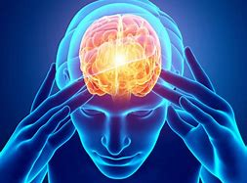

Contact information: apradhan1@geisinger.edu

