Slide 1

The 2023 NIH Data Management and Sharing Policy: Practical Advice for Data Sharing
Andrea Burnett-Hartman, PhD, MPH
KPCO Institute for Health Research
June 2023
Thanks to Larry Kushi and Alex Kramer
Note: Views/Opinions presented represent my own and do not represent KP or NIH

Slide 2
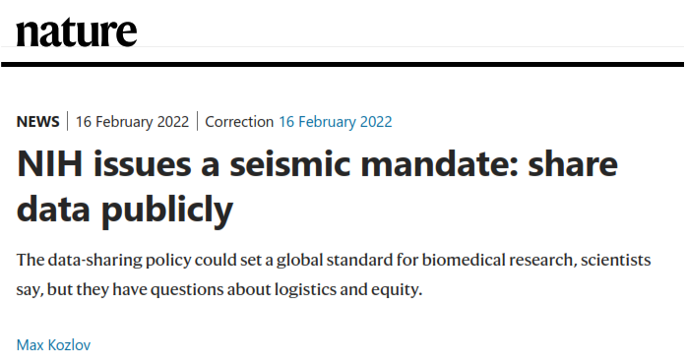


Slide 3

Is the New NIH Data Sharing Policy Really a Big Change?

Slide 4
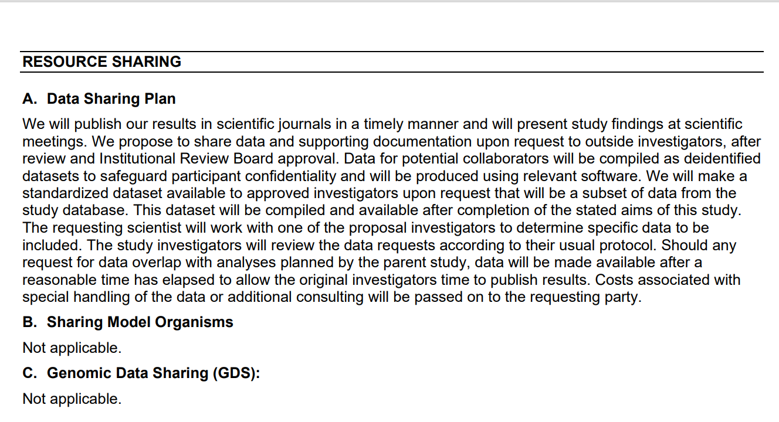
Old Way

Slide 5
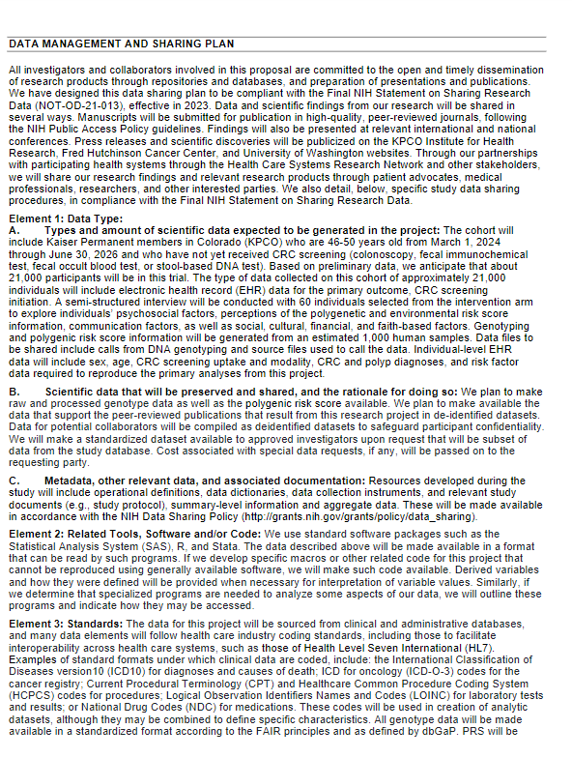
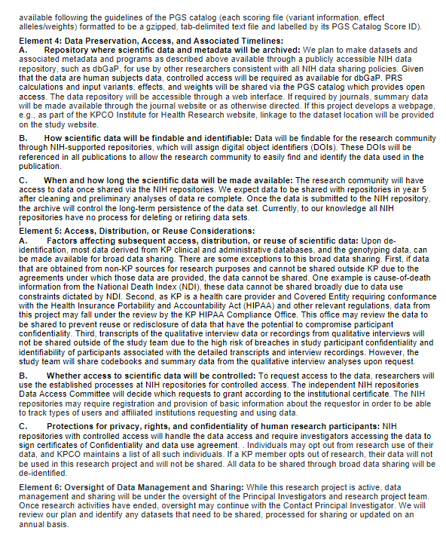
New Way

Slide 6
Comparison Between Key Aspects of 2003 and 2023 NIH Data Sharing Policies
2003 (NOT-OD-03-032) | 2023 (NOT-OD-21-013)
Applicable until 1/24/2023 | Applies to due dates on and after 1/25/2023
Silent on data sharing costs | Costs for implementation of a DMSP allowed and should be in Budget Justification
Applications with direct costs >$500,000 in any year | Applies to essentially all NIH applications (grants, contracts, etc.)
Plan is part of conditions of award | No change
Plan submitted with application | No change
 | Specific elements for DMSP outlined
 | Deposition of data into NIH repository strongly encouraged
 | Annual progress report will include progress towards compliance with DMSP
 | Failure to comply may impact future NIH funding for your institution
 | Incorporates FAIR and TRUST principles for data sharing

Slide 7
FAIR Principles for Data Sharing
Principle | Guidance for repositories
Findable | Data are described by unique, persistent metadata including an identifier that is registered or indexed in a searchable resource
Accessible | Metadata (and data) are retrievable by using common protocols that are open, free, and universally implementable
Interoperable | (Meta)data use a formal, accessible and broadly shared language for knowledge representation
Reuseable | (Meta)data are richly annotated with relevant attributes, with clear provenance, data use parameters, and community standards

Slide 8
TRUST Principles for Data Sharing
Principle | Guidance for repositories
Transparency | To be transparent about specific repository services and data holdings that are verifiable by publicly accessible evidence.
Responsibility | To be responsible for ensuring the authenticity and integrity of data holdings and for the reliability and persistence of its service.
User Focus | To ensure that the data management norms and expectations of target user communities are met.
Sustainability | To sustain services and preserve data holdings for the long-term.
Technology | To provide infrastructure and capabilities to support secure, persistent, and reliable services.

Slide 9
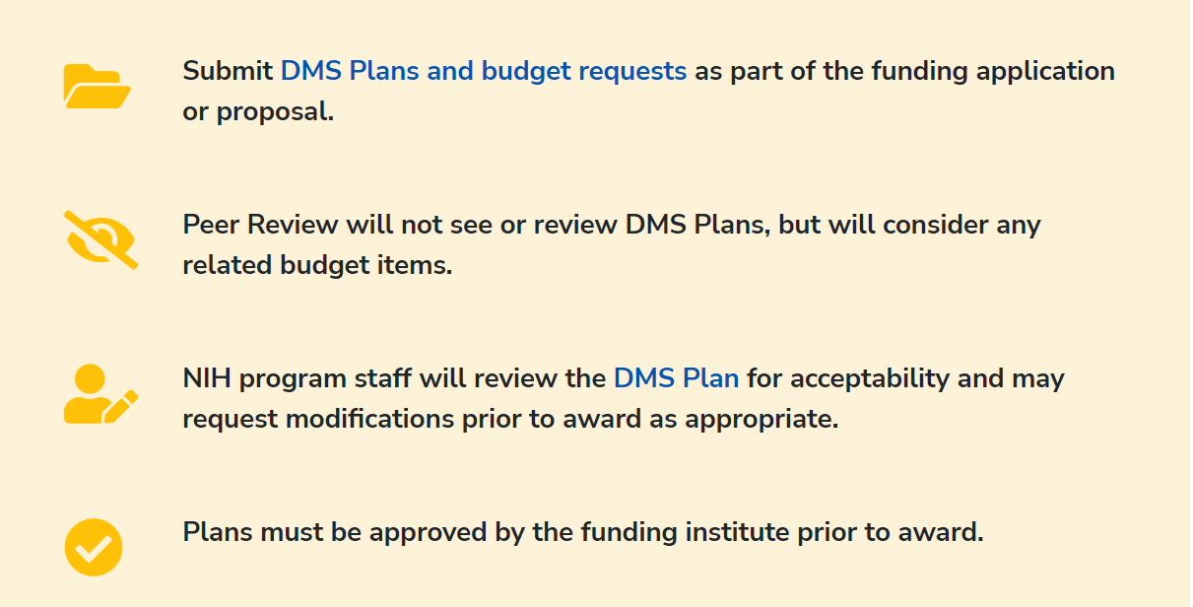
Process
Effective January 25, 2023, NIH implemented the Data Management and Sharing (DMS) policy to promote the sharing of scientific data and data reuse for future research studies. If another applicable policy has more detailed expectations than that of the DMS Policy, those expectations should be followed in addition to the DMS Policy (e.g., clinical trials, research generating large-scale genomic data).

Slide 10
Selecting a Data Repository
For some programs, Funding Opportunity Announcements (FOAs) identify particular data repositories (or sets of repositories) to be used to preserve and share data
For scientific data from research for which no data repository is specified, select a data repository appropriate for the data
Primary consideration should be given to data repositories that are discipline or data-type specific to support effective data discovery and reuse
If no appropriate discipline or data-type specific repository is available, a variety of other options include:
  For small datasets (up to 2 GB in size), inclusion as supplementary material to accompany articles submitted to PubMed Central
  Generalist repositories or institutional repositories, that make data available to the larger research community, institutions, or the broader public

Slide 11
Compliance with NIH DMS Policy
During Funding or Support Period
The Plan will become a Term and Condition of the Notice of Award. Failure to comply with the Terms and Conditions may result in an enforcement action, including additional special terms and conditions or termination of the award, and may affect future funding decisions
Post Funding or Support Period
After the end of the funding period, non-compliance with the NIH-approved Plan may be taken into account by NIH for future funding decisions for the recipient institution (e.g., as authorized in the NIH Grants Policy Statement, Section 8.5, Special Award Conditions, and Remedies for Noncompliance (Special Award Conditions and Enforcement Actions))

Slide 12
Data Management and Sharing Plan
Tips based on lessons learned for KP applications

Slide 13
Data Management and Sharing Plan (DMSP)
Element 1: Data Type
  A. Types and amount of scientific data expected to be generated in the project
  B. Scientific data that will be preserved and shared, and the rationale
  C. Metadata, other relevant data, and associated documentation
Element 2: Related Tools, Software and/or Code
Element 3: Standards
Element 4: Data Preservation, Access, and Associated Timelines
  A. Repository where scientific data and metadata will be archived
  B. How scientific data will be findable and identifiable
  C. When and how long the scientific data will be made available
Element 5: Access, Distribution, or Reuse Considerations
  A. Factors affecting subsequent access, distribution, or reuse of scientific data
  B. Whether access to scientific data will be controlled
  C. Protections for privacy, rights, and confidentiality of human research participants
Element 6: Oversight of Data Management and Sharing

Slide 14
Tips for Element 1A
(Types and amount of scientific data)
DO
State if the data is being collected through informed consent or a waiver of consent
Keep this section focused solely on the type, amount, source and format of the data being collected/generated
Address any genomic data
AVOID
Being vague, general or generic in your description of the data
Discussing other elements of the plan, such as how the data will be shared or the restrictions on data sharing
Providing so much specificity on data elements that minor changes to the data would require updates to the plan

Slide 15
Tips for Element 1B
(Data that will be preserved and shared, and the rationale)
DO
Provide specifics on the data being shared under this plan
Provide specific information on the factors that impact sharing
Be explicit about which elements of the data will and cannot be shared and the rational
Provide information on agreements if any of the data mentioned in Element 1A is coming from outside sources
AVOID
Discussing other elements of the plan, such as how the data will be shared
Using empty statements, such as “laws/agreements may apply and restrict ability to share certain scientific data”, without citing specific laws/regs/agreements

Slide 16
Tips for Element 1C
(Metadata, other relevant data, and associated documentation)
DO
Include information on study protocols, data collection instruments, and data dictionaries that will be made accessible

Slide 17
Tips for Element 2
(Related Tools, Software and/or Code)
DO
Provide information on tools, software, and/or code that are needed to access or manipulate shared data
Provide the specific name(s) of the needed tool(s) and software (e.g. SAS, Stata, R)
Specify how tools and or software can be accessed

Slide 18
Tips for Element 3
(Standards)
DO
Provide information on what common data standards will be applied to the data
Provide the name(s) of the data standards applied (e.g. VDW, HL7, OMOP)
If applicable, indicate that no consensus standards exist

Slide 19
Tips for Element 4A
(Repository where scientific data and metadata will be archived)
DO
Specify which repository will be used
Ensure repository meets your institution’s data sharing standards
List all locations where data will be deposited if not all data can be deposited into a single repository
AVOID
Being vague, general or generic, or simply restating the policy (e.g. We will make datasets available via a publicly accessible data repository)
Making claims about the repository that aren’t accurate
Stating that data will not be deposited into a repository without a rational

Slide 20
Tips for Element 4B
(How data will be findable and identifiable)
DO
Provide specific information for the repository being used
AVOID
Being vague, general or generic
Making statements that are inconsistent with the repository being utilized
Broad statements that don’t provide project specific information (e.g. Datasets will be identified in publications, project websites, and presentations.)

Slide 21
Tips for Element 4C
(When and how long the data will be made available)
DO
Provide specific information for the timing of data deposition
Specify if multiple datasets will be deposited
Provide a specific period you/your institution can reasonably commit to
AVOID
Agreeing to maintain data at your local institution for a period in excess of 3-5 years, and not “indefinitely” or “for perpetuity”
Make statements that are inconsistent with the repository being utilized

Slide 22
Tips for Element 5A
(Factors affecting subsequent access, distribution, or reuse of data)
DO
Provide specific limitations only on the data being shared under this plan
Provide specific information on the factors that impact subsequent access, distribution, or reuse (e.g. consent form, laws, patient privacy)
AVOID
Being vague, general or generic (e.g., A waiver of informed consent will be requested for this project.)
Discussing other elements of the plan, such as categories of data that will NOT be shared
Using empty statements such as “laws/agreements may apply and limit subsequent access, distribution, or reuse of certain scientific data”, without citing specific laws/regs/agreements

Slide 23
Tips for Element 5B
(Whether access to scientific data will be controlled)
DO
Provide information about the access review process, if applicable
Provide enough information/rationale if the data will be held by your institution and not shared in a public repository
Provide meaningful description of the process for requesting access if the data will be maintained, or stored in a repository, by your institution
AVOID
Being vague, general or generic (e.g., the above repositories may require registration and provision of basic information about the requestor in order to be able to track types of users and affiliated institutions requesting and using data)
Including information that doesn’t speak specifically to repository (or other mode of access) identified under your specific plan

Slide 24
Tips for Element 5C
(Protections for privacy, rights, and confidentiality of human research participants)
DO
Provide specific information on how human subjects data will be protected under the study (e.g. de-identification)
Discuss Certificates of Confidentiality (if applicable)
AVOID
Being vague, general or generic
Including information about repository capabilities that aren’t verified
Making blanket statements regarding your institution’s ability to share member data (e.g. All members are notified upon enrollment that their data from electronic health records and related databases may be used for research purposes.)

Slide 25
Tips for Element 6
(Oversight of Data Management and Sharing)
DO
Provide specific information on who is responsible, the monitoring schedule and how compliance will be verified
Include an external monitor as part of the plan (e.g. Research Compliance Program)
AVOID
Implying self-monitoring by PI

Slide 26
Practical Advice for Data Sharing
Trivia Round

Slide 27

Plan in Advance
Spend some time on the Data Management and Sharing Plan
  Template at: https://sharing.nih.gov/data-management-and-sharing-policy/planning-and-budgeting-for-data-management-and-sharing/writing-a-data-management-and-sharing-plan#after
Build consensus with all partners prior to grant submission
Identify possible existing data repositories

Slide 28

Don’t Over-Promise
Qualitative data
Non-response survey
Shared to you from another source that may have its own data sharing governance (NDI, KPRB, Epic variables)

Slide 29

Budget Appropriately for Data-Sharing
De-identification
Testing
Documentation
dbGaP
Be specific about resources needed for data sharing in the budget justification

Slide 30

Think About Your Timeline
Too early in the project and it’s difficult to identify data problems
Too late in the project and you run out of time to do the testing and documentation needed
Start building the code for data sharing and documentation early
Could be an ongoing process

Slide 31

Plan for Possible Discussions with NIH
Share concerns about PHI identifiability
  Small health systems; census-based measures; rare groups
  Qualitative data
Understand institutional risk concerns
  Masking or not providing site ID
Understand IRB and HIPAA compliance issues

Slide 32

Future Usability of Shared Data
How long with the data be available for use?
Reasonable timeline to sunset data set?
Harmonization is difficult – Not one standard format required
Data context may be missing from shared data

Slide 33
Discussion / Questions?

